Slide 1
Dijkstra’s algorithm

Slide 2
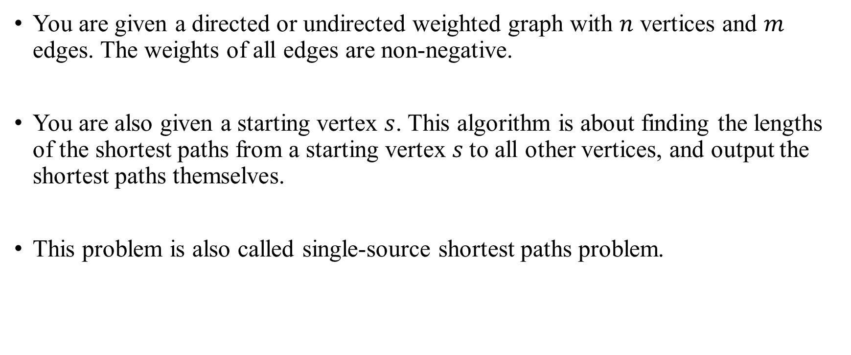
Dijkstra’s algorithm
You are given a directed or undirected weighted graph with $n$ vertices and $m$ edges. The weights of all edges are non-negative.
You are also given a starting vertex $s$. This algorithm is about finding the lengths of the shortest paths from a starting vertex $s$to all other vertices, and output the shortest paths themselves.
This problem is also called single-source shortest paths problem.

Slide 3
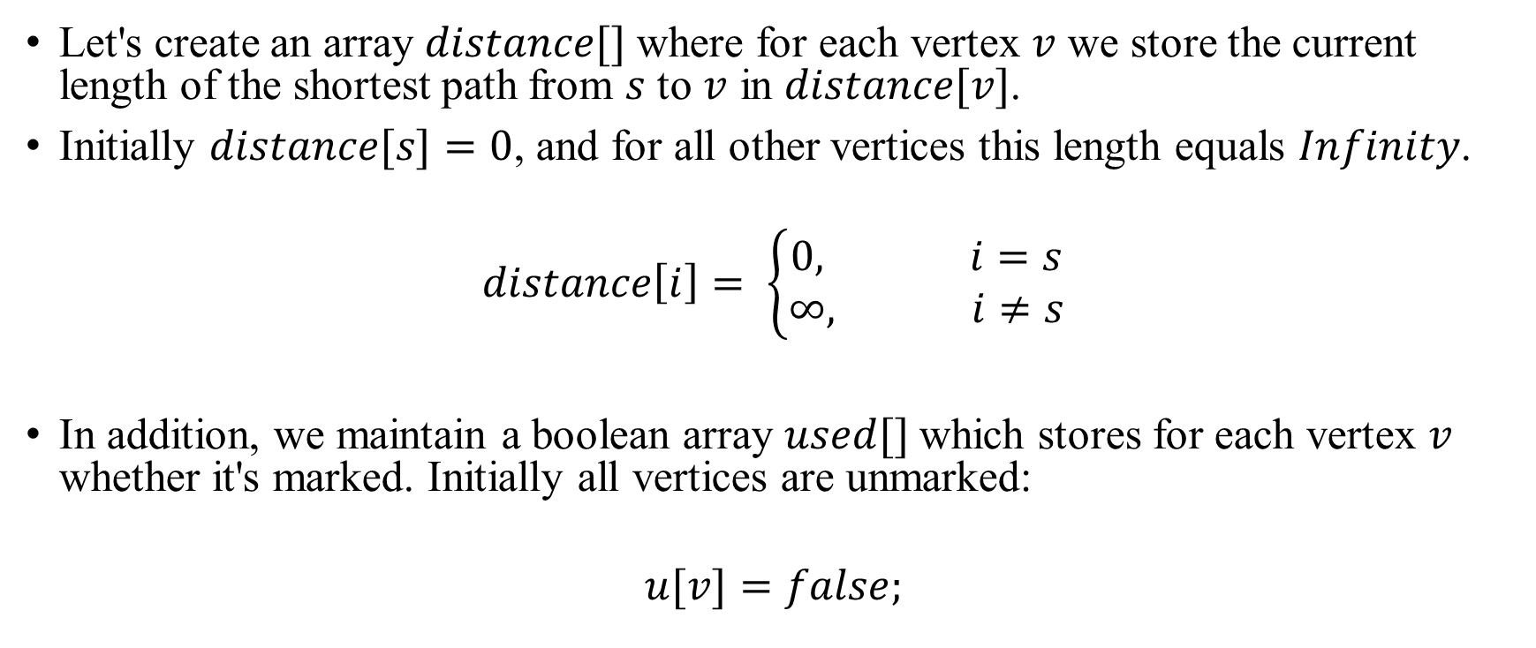
Dijkstra’s algorithm Algorithm
Let's create an array $distance[]$ where for each vertex $v$ we store the current length of the shortest path from $s$ to $v$ in $distance[v]$.
Initially $distance[s]=0$, and for all other vertices this length equals $Infinity$.
$$distance\left[i\right]= \left\{\begin{aligned}0, i=s \\ ∞, i≠s\end{aligned}\right.$$
In addition, we maintain a boolean array $used[]$which stores for each vertex $v$ whether it's marked. Initially all vertices are unmarked:
$$u[v]=false;$$

Slide 4
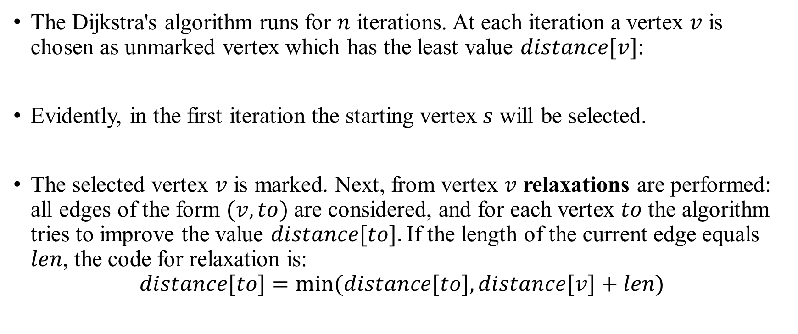
Dijkstra’s algorithm Algorithm
The Dijkstra's algorithm runs for $n$ iterations. At each iteration a vertex $v$ is chosen as unmarked vertex which has the least value $distance[v]$:
Evidently, in the first iteration the starting vertex $s$ will be selected.
The selected vertex $v$ is marked. Next, from vertex $v$ relaxations are performed: all edges of the form $(v, to)$ are considered, and for each vertex $to$ the algorithm tries to improve the value $distance[to].$If the length of the current edge equals $len$, the code for relaxation is:
$$distance[to]=min⁡(distance[to],distance[v]+len)$$

Slide 5
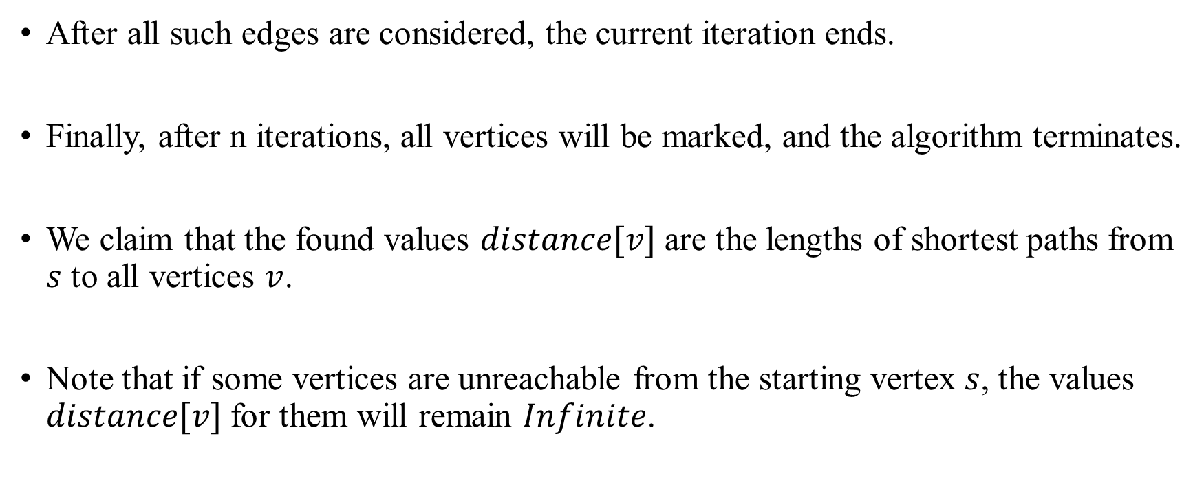
Dijkstra’s algorithm Algorithm
After all such edges are considered, the current iteration ends.
Finally, after n iterations, all vertices will be marked, and the algorithm terminates.
We claim that the found values $distance[v]$ are the lengths of shortest paths from $s$ to all vertices $v$.
Note that if some vertices are unreachable from the starting vertex $s$, the values $distance[v]$ for them will remain $Infinite$.

Slide 6
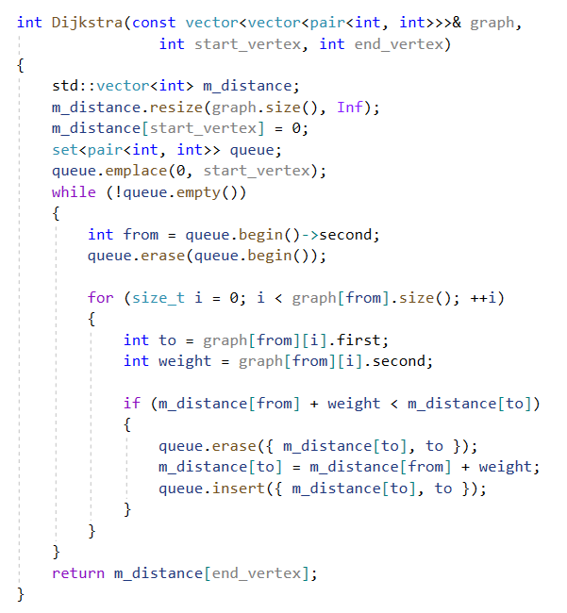
Dijkstra’s algorithm Implementation

